Slide 1
Mapping Subjective Social Status Through Data and Models
Neha Deshpande, Witlie Leslie, Phuong Nguyen

Slide 2
introduction
Topic Overview: Social class impacts health, typically measured through income, education, and job status.
Study Focus: Explores whether subjective social status—how children see their social rank—also predicts self-rated health.
Why It Matters: Objective measures (e.g., money or parental jobs) don’t always capture children's lived experiences or perceptions.
Study Details: Based on survey data from children in four countries, assessing self-perceived social status and health.
Our Interest: We wanted to understand how children view their place in society beyond material wealth.
What We Did: Used data visualization and machine learning to analyze patterns and test relationships in the data.

Slide 3
Exploratory analysis
Explored children's self-perceived social status ("stairs" on MacArthur Ladder)
Analyzed relationships between social status and material indicators:
Qhouse (housing)
Qfood (food access)
Qmoney (financial stability)
Qthings (possessions)
Dataset covered multiple countries to allow regional comparisons

Slide 4
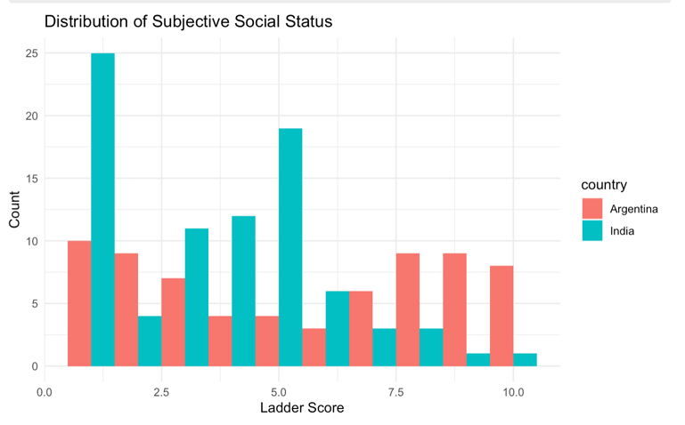
Country-Level Correlations (India & Argentina)
Focused EDA on India and Argentina
Correlation analysis between stairs and material indicators:
India: Strongest correlations with money and possessions
Argentina: Strongest correlation with food access
Suggests regional variation in what drives perceived status

Slide 5
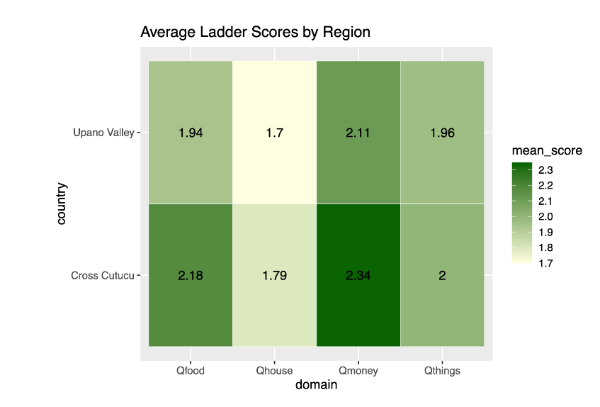
Ecuador Regional Comparison
Demographics nearly identical (age ~10.7, ~53% male)
Cross Cutucú consistently scored higher
Suggests stronger community support and stability in Cross Cutucú
Supported by literature on Shuar kinship networks
Upano’s lower scores may relate to market pressures

Slide 6
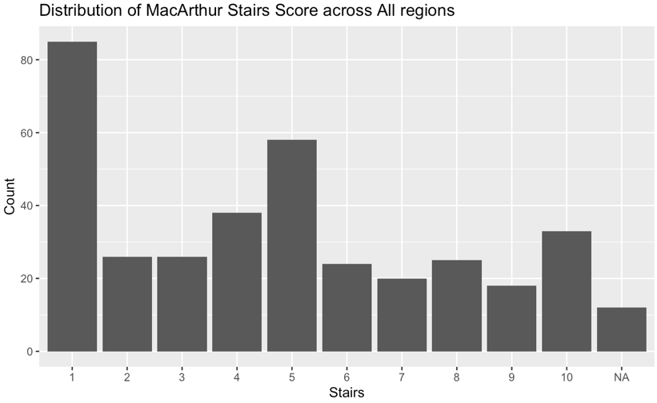
Overall Distributions
Age: Slight right-skew, peak at 8 years; ranged from 4 to 18
Gender: Uniform distribution
Stairs (status) distribution:
Multimodal, most frequent response = 1
Suggests many children see their families as low-status
Next peak = 5, indicating perceptions of being average

Slide 7
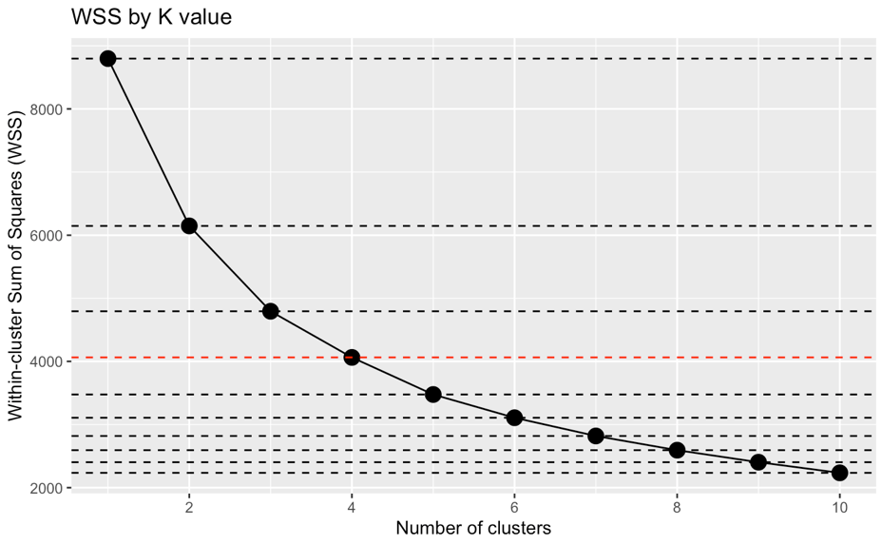
Cluster analysis
Identify groupings of similar responses
Compared within-cluster sum of squares (WSS) to determine optimal K value
The decrease in WSS becomes less significant after 4 clusters

Slide 8
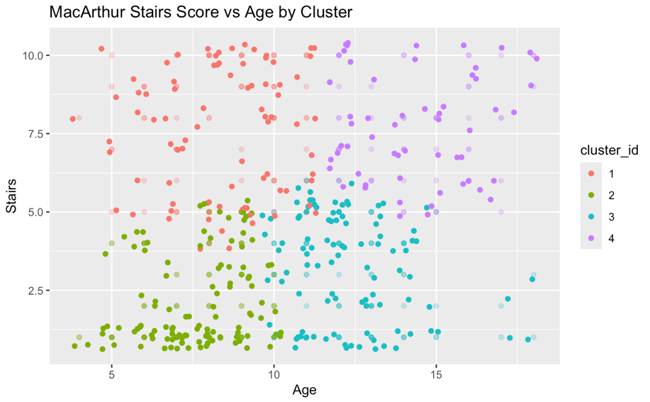
Cluster analysis
Analysis included all numerical variables from dataset
Visualized using just 2 variables: Age and Stairs
4 clusters identified:
Younger with lower subjective social status
Younger with higher subjective social status
Older with lower subjective social status
Older with higher subjective social status

Slide 9
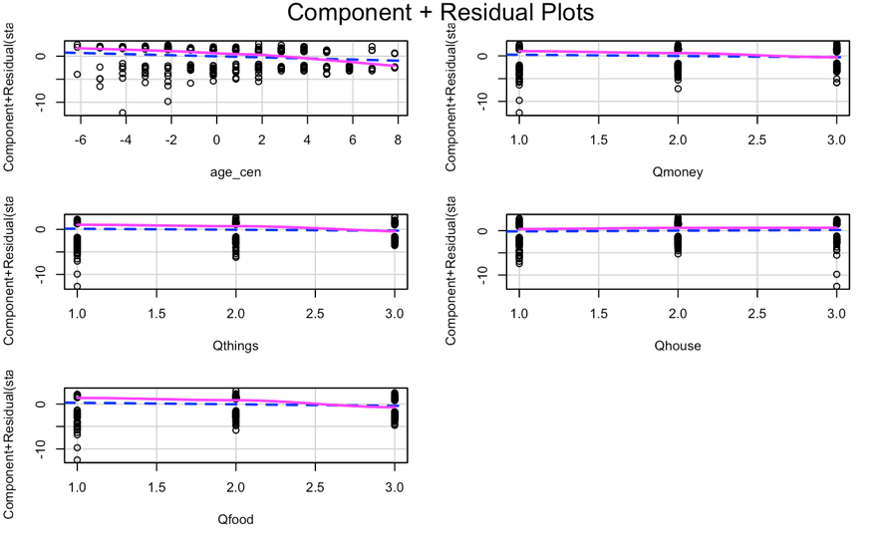
Logistic regression
Binary response variable
High subjective social status (stairs >= 5)
Low subjective social status (stairs < 5)
Checked model assumptions
Approximately straight lines on residual plots indicate linearity
Variance inflation factor was low for each variable (< 2) indicating low multicollinearity

Slide 10
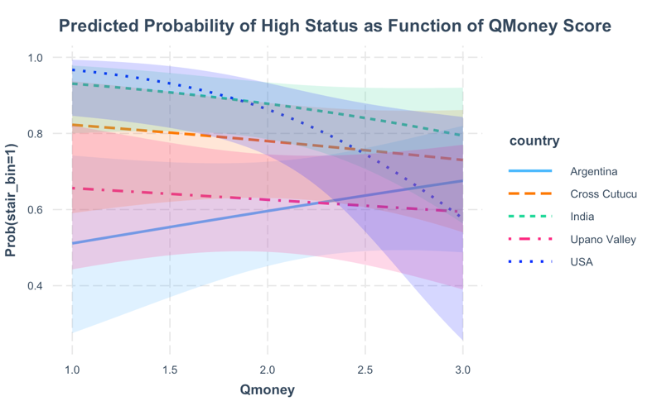
Logistic regression
Tested multiple interaction terms
Only significant interaction was between country and Qmoney (p-value = 0.012)
Graph visualizes the probability of high status based on Qmoney score by region
For most regions, probability of high status decreases as sense of money decreases
This relationship is slightly reversed for Argentina
Perhaps this indicates differences in cultural measures of status?

Slide 11
ML model
Goal: Predict children's subjective social status using:
Age
Sex
Country
Material Index (average of housing, food, money, and possessions)
Model Type: Random Forest Regression
Context: Part of a broader project exploring how children perceive their social standing across countries. We aimed to use data to predict how children feel about their place in society.

Slide 12
ML model
Performance:
R² on training data: 8.76%
R² on test data: 10%
Mean Squared Error: 6.92
Interpretation:
Model captures some patterns but explains only a small portion of variance → likely underfitting.
Possible reason: Limited predictive power of selected features or need for more nuanced inputs.

Slide 13
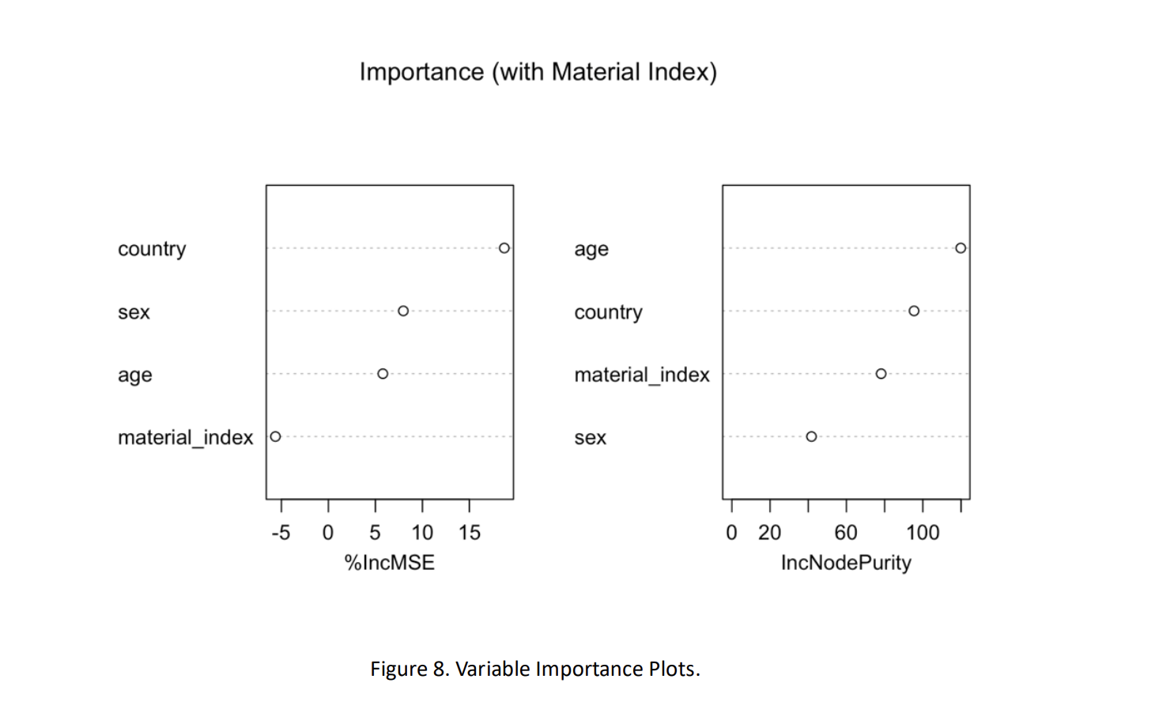
ML model
Two Metrics Used:
%IncMSE: Measures how prediction error increases if a variable is excluded.
IncNodePurity: Measures how much a variable improves tree splits.
Top Predictors:
Material Index (most important by %IncMSE)
Age (most important by IncNodePurity)
Sex and Country were less informative.
Takeaway: Material conditions and age are most influential in shaping children's perceived
social status.

Slide 14
Dashboard
Filter Panel
Filtered Data Table
Model Comparison
Ladder Score Prediction Interface
Logistic Regression Insights
Geographic Visualizations

Slide 15
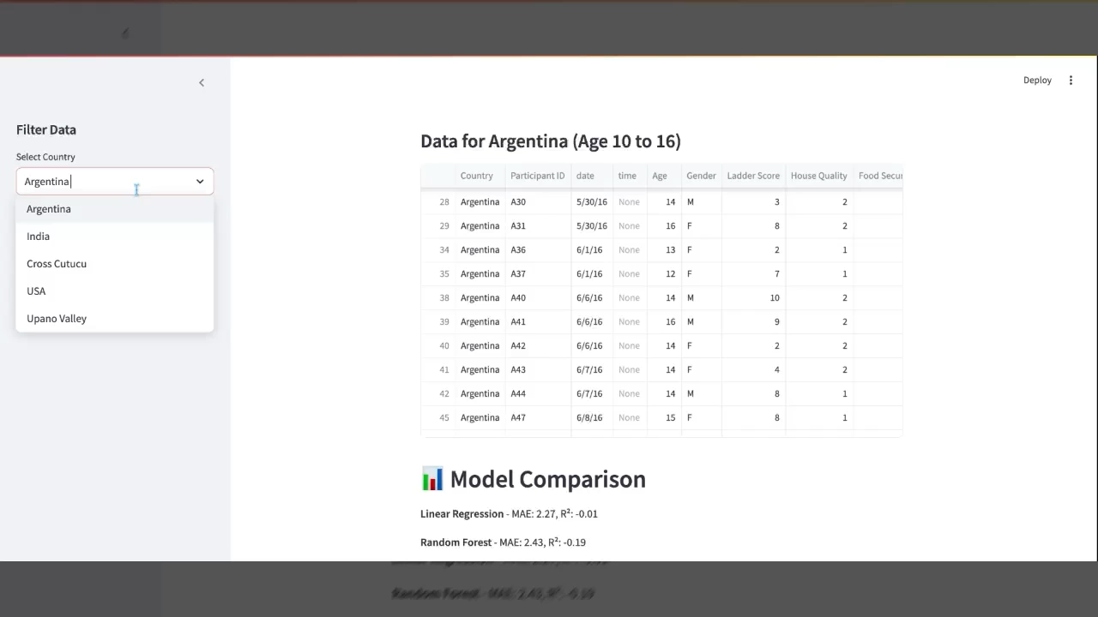

Slide 16
conclusion
Our cluster analysis identified 4 intuitive groupings. Our failure to find any more intriguing clusters may be due to the relatively small size of our data.
Logistic regression uncovered the interaction between country and Qmoney, a relationship that was reversed for Argentina, potentially suggesting a difference in the cultural importance of money to social status.
While the Random Forest model identified age and material conditions as key predictors, its low R² (~10%) suggests that children’s perceived social status is influenced by additional unmeasured factors beyond the inputs used.

Slide 17
Citations
Amir D, Valeggia C, Srinivasan M, Sugiyama LS, Dunham Y (2019) Measuring subjective social status in children of diverse societies. PLOS ONE 14(12): e0226550. https://doi.org/10.1371/journal.pone.0226550
DataCamp. (n.d.). Python tutorial: Streamlit. DataCamp. Retrieved April 27, 2025, from https://www.datacamp.com/tutorial/streamlit Ditmars, H. (2024, January 19).
Why the ancient Amazonian cities recently discovered in Ecuador are so significant. The Art Newspaper. https://www.theartnewspaper.com/2024/01/19/ecuador-amazonian-settlementslidarupano-valley(The Art Newspaper) Open Case Studies. (2020, January 27).
Why the struggles of the Shuar Indigenous People in Ecuador to conserve their culture are key to local conservation. The University of British Columbia. https://cases.open.ubc.ca/why-the-struggles-of-the-shuar-indigenous-peoplein-ecuador-to-conserve-their-culture-are-key-to-local-conservation/
Streamlit. (n.d.). Create an app. Streamlit Documentation. Retrieved April 27, 2025, from https://docs.streamlit.io/get-started/tutorials/create-an-app
Streamlit. (n.d.). Streamlit [YouTube channel]. YouTube. Retrieved April 27, 2025, from https://www.youtube.com/@streamlitofficial

